Slide 1
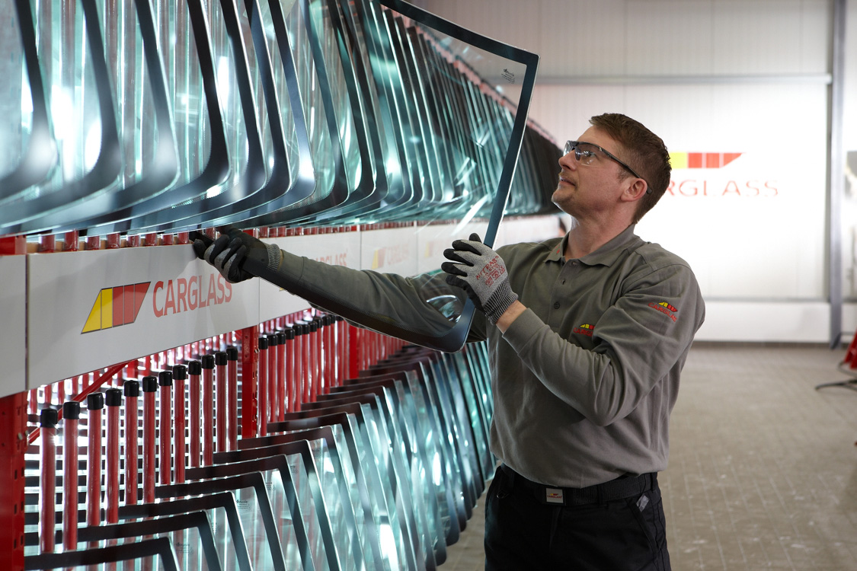
SLA´s & Priority definitions
IT Shared Services
January, 2024

Slide 2
CONTENTS
1 Global Service Level Agreements
2 Incident Priority Definitions

Slide 3
Global Service Level Agreements - Belron
Priority | Urgency | Impact | Response time | Response Time Threshold | Resolution time | Resolution Time Threshold | Belron Standard Operational Hours
Priority 1 | Business Critical | All users | 15 min | 95% | 4hr | 95% | 24x7x365
Priority 2 | Business Critical | Multiple Users | 30 min | 95% | 16hr | 95% | 24x7x365
Priority 3 | Business Critical | Single User | 2 hr | 90% | 24 hr | 90% | 24x7x365
Priority 4 | Non-Business Critical | Multiple Users | 4hr | 90% | 3 days | 90% | 8x5*
Priority 5 | Non-Business Critical | Single User | 4hr | 90% | 5 days | 90% | 8x5*
Service Request | Non-Business Critical | Single/multiple Users | N/A | N/A | Note 2 | N/A | 8x5*
*Note: Urgency is not the same as Priority. A ticket may be urgent, but not a Priority 1 or 2

Slide 4
Incident Priority Definitions - Belron
Priority | Impact | Definition
Priority 1 | Business Critical - All Users | A production system is not available; the incident disrupts an important component or critical business process in one or more business units and involved parties cannot work around the disruption manually. The problem has caused work to stop immediately and completely, which is affecting a primary business process or a broad group of users, such as an entire department, floor, branch, line of business or external customer. There is no available way to work around this problem.
Priority 2 | Business Critical - Multiple Users Major Business Impact | Mission-critical application or service resource Threshold reached; mission-critical application or service rendered partially unusable. The incident affects a business process to such a great extent that it degrades a business function and affects multiple users or a key customer. There may be a way to work around this problem, but the solution is not easily sustainable.
Priority 3 | Business Critical - Single User Moderate Business Impact | Mission-critical application or service resource Threshold reached; mission-critical application or service rendered partially unusable. The incident impacts one person, however, to such a great extent that it affects the overall organisation's ability to deliver service to customers in a timely or effective way. There may be a way to work around this problem, but the solution is not easily sustainable.
Priority 4 | Not Business Critical - Multiple Users Minimal Business Impact | The incident affects multiple people with limited impact on a business process, and the provider can handle it on a scheduled basis. There is a way to work around this problem.
Priority 5 | Not Business Critical - Single User Minimal Business Impact | The incident affects a single person with little impact on normal business processes, and the provider can handle it on a scheduled basis. There is a way to work around this problem.
Service Request |  | Service requests range from ones that urgently require attention, to more day-to-day requests like changing application authorizations or replacing individual records or settings. These can include process workflows that need planning by application or infrastructure support and management approval.

